Slide 1

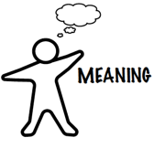
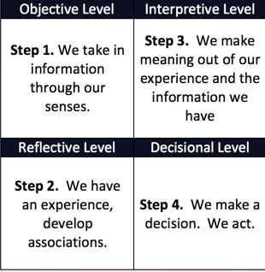

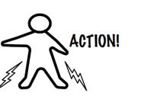
Consensus Workshop: Facilitating Agreement
Images on this cover and throughout this deck are from Dendros Group, from their Good Work Tool set.
See http://dendros.com/good-work-tools/
California SNAP-Ed ToP Facilitation Virtual Mentoring Project

Slide 2

Session 3 Focused on engaging the group with Focused Conversation. What else do we do with the Focused Conversation method?
The questions flow through four levels: from
Objective to
Reflective to
Interpretive to
Decisional.......
This image helps us imagine how an initial focused conversation could flow right into a next one....
California SNAP-Ed ToP Facilitation Virtual Mentoring Project

Slide 3
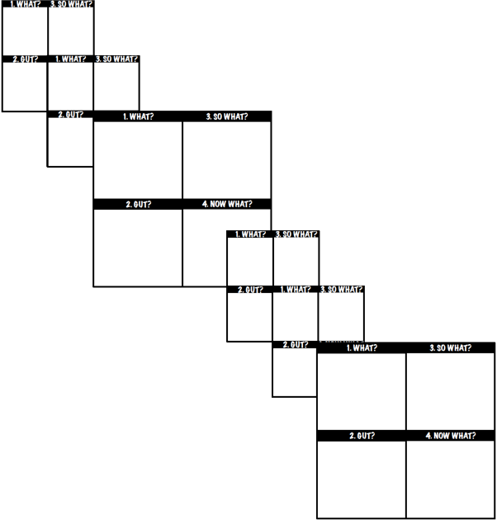
The Focused Conversation method plays well with others
Combine the Focused Conversation method with other processes to create the meeting you need
Cycling through the four levels takes you deeper and deeper into your topic
A special combination of steps called Consensus Workshop method helps the group reach shared agreement
California SNAP-Ed ToP Facilitation Virtual Mentoring Project

Slide 4
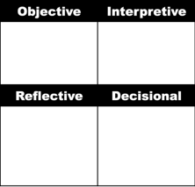
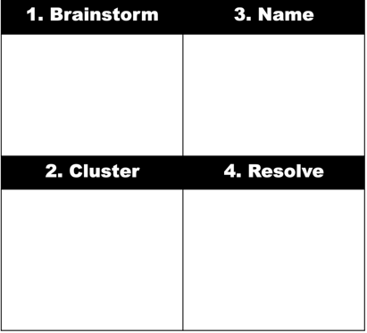
Applications in SNAP-Ed Work
Use Focused Conversation to raise awareness about health communities and nutrition
Use Consensus Workshop to identify ways the community can address their issues
California SNAP-Ed ToP Facilitation Virtual Mentoring Project

Slide 5
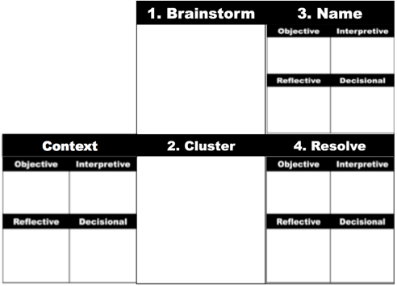
Consensus Workshop Method - Context
Context lays the foundation for the workshop. Introduces the topic, process and expected time
Post Focus Question where it is easy to see.
Beginning with a focused conversation related to the focus question gets people thinking about their own experiences and knowledge. Sometimes this can include a guided visualization to really gets thoughts flowing
O = Round robin - EASY
R = Memories and personal experiences
I = Consider implications, options, alternatives
D = Participants working individually & in silence write down their ideas. The individual D level work carries over into Step 1 Brainstorm
California SNAP-Ed ToP Facilitation Virtual Mentoring Project

Slide 6
Consensus Workshop Method - Step 1 Brainstorm
The individual brainstorm gets everyone’s ideas into the process.
Provide instructions
Star top ideas
Brainstorm x-y answers
3-7 words per card
Write Big Like This
One Idea per card
Number of ideas per pair/group
Work in small teams. Review starred items first. Work together to select ideas to be shared and word them clearly. (First step in building consensus)
People brainstorm their individual ideas on a question - gets everyone's ideas into the process.
Collect 12-15 cards and place randomly on wall
California SNAP-Ed ToP Facilitation Virtual Mentoring Project

Slide 7
Consensus Workshop Method - Step 2 Cluster
In clustering, the work is making associations. (R level)
Clustering begins with pairing similar ideas.
But similar on what basis? Think about what you are trying to achieve….
A list of elements?
Work that needs to be done?
Factors contributing to a problem?
To tap the method’s power, you must know what you are trying to achieve
People brainstorm their individual ideas on a question - gets everyone's ideas into the process.
Consider ideas in an organized way (taking cards up in rounds of 10-15 cards each) and cluster similar ideas together
After forming 4-6 pairs that represent different ideas, build up clusters until all cards have a placed.
California SNAP-Ed ToP Facilitation Virtual Mentoring Project

Slide 8
Consensus Workshop Method - Step 3 Name
Naming is a focused conversation in itself:
O = Data – read the cards
R = Associations or memories triggered by the ideas. Ask for examples
I = Searching for insights, themes, common threads
D = Brainstorm possible names. Name the cluster when the group agrees. (Watch body language)
People brainstorm their individual ideas on a question - gets everyone's ideas into the process.
Name each cluster using language that captures the essence of all the ideas in the cluster
Consider ideas in an organized way and cluster similar ideas together
Names should be evocative and embrace every idea in the cluster
California SNAP-Ed ToP Facilitation Virtual Mentoring Project

Slide 9
Consensus Workshop Method - Step 4 Resolve
In resolve, you are confirming consensus and building ownership. This is also a focused conversation
O = Data – read the titles
R = Surface reactions, emotions
I = Look for how the titles fit together - how the concepts are integrated
D = Confirm agreement, define next steps and responsibilities
People brainstorm their individual ideas on a question - gets everyone's ideas into the process.
Name each cluster using language that captures the essence of all the ideas in the cluster
Consider ideas in an organized way and cluster similar ideas together
Reflect on the names, confirm their fit, how they relate to the group and its goals. Determine next steps, timing, responsibilities, etc.
Document the results – Use a table – first row is the Name. The Name is the consensus. Second row holds all the data. cards. Fit to one page.
California SNAP-Ed ToP Facilitation Virtual Mentoring Project

Slide 10
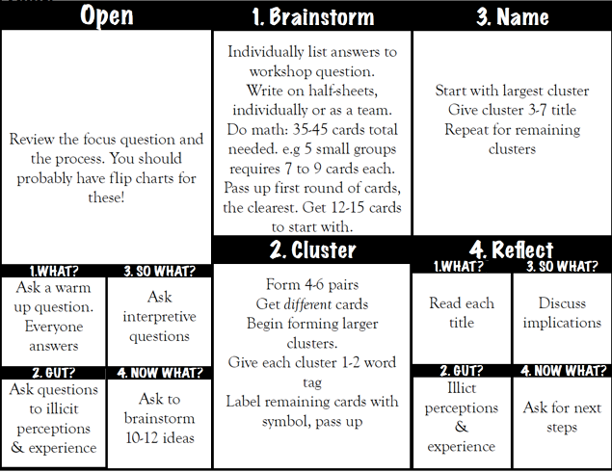
High level overview of Consensus Workshop method
California SNAP-Ed ToP Facilitation Virtual Mentoring Project

